Slide 1


Project Presentation on Development & Testing
Team: SAZAM

Slide 2
Employee Management System - Development

Slide 3
Team SAZAM
Sandeep Naik : 300366
Akshay Chavan : 300360
Mohammed Zabiulla : 300372
Arpita Sarvi : 300367
Mayuresh Shivravdekar : 300370
Instructor : Saravanan R

Slide 4
Description
Employee Management System is a software that helps in managing the information of employees in the company.
Project Environment
OS: Windows
Database: Oracle
Programming Language: J2EE, HTML, CSS.

Slide 5
Product Features
Sign Up
Login
Session Management
Add Employee
View Employee
Search Employee
Logout
Mobile Friendly

Slide 6
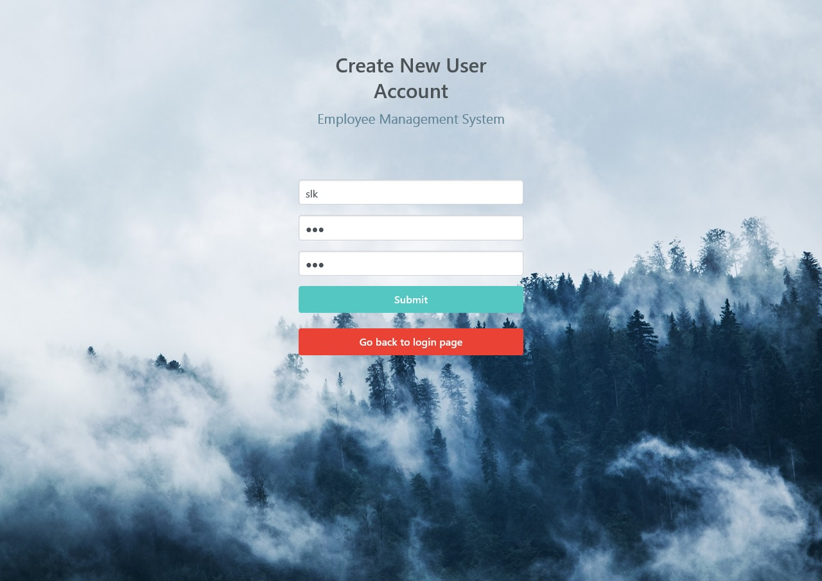
Sign Up

Slide 7
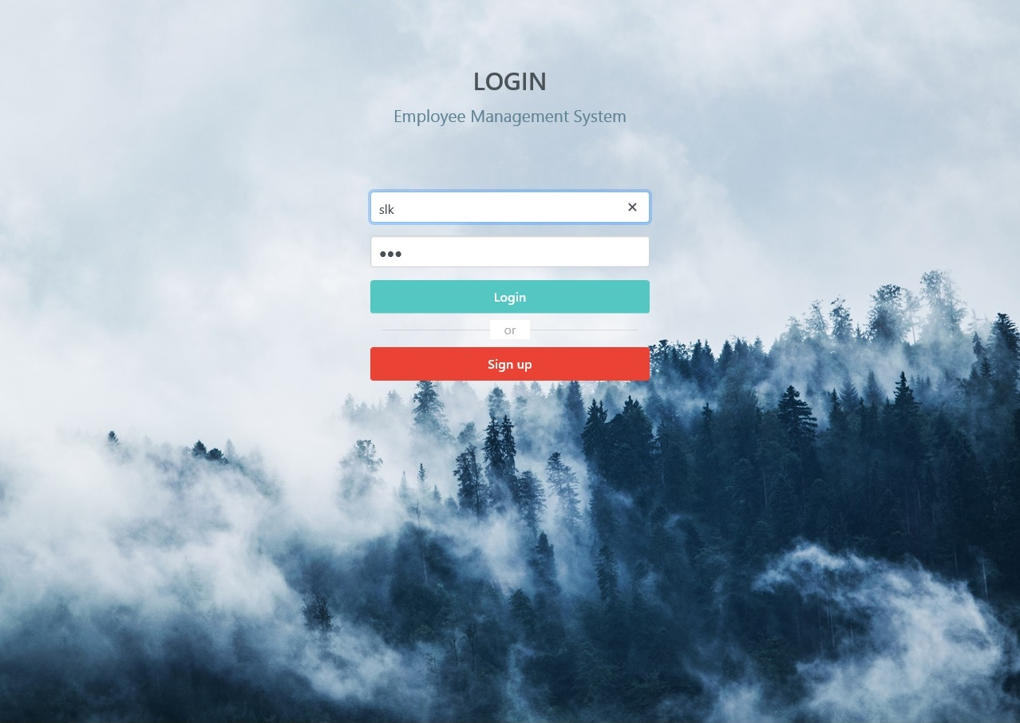
Login

Slide 8
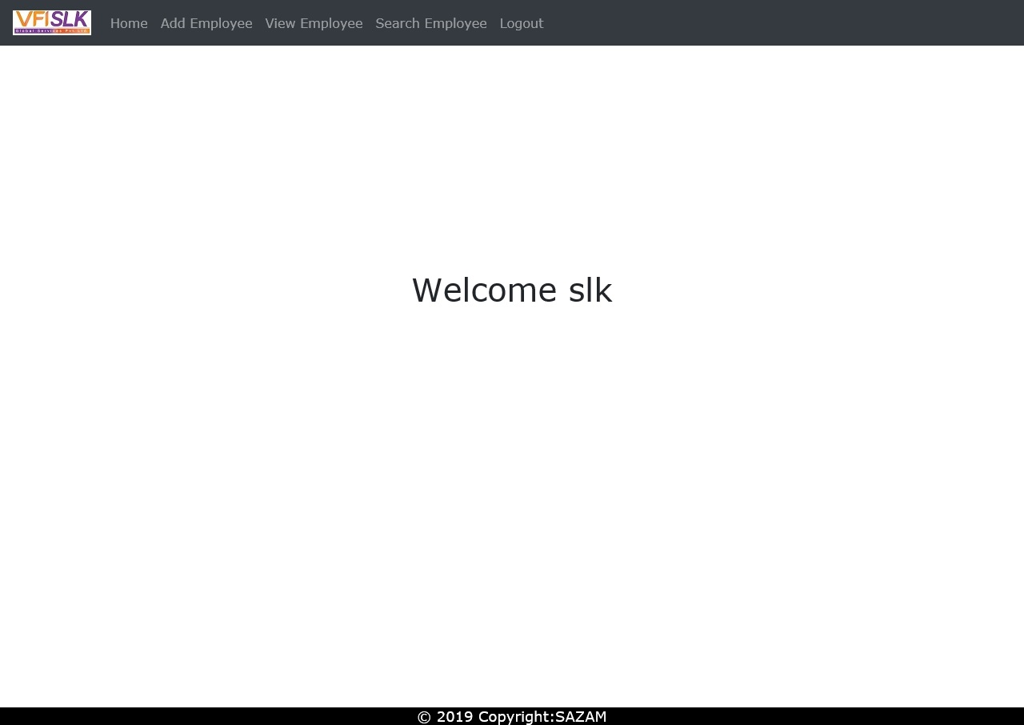
Home Page

Slide 9
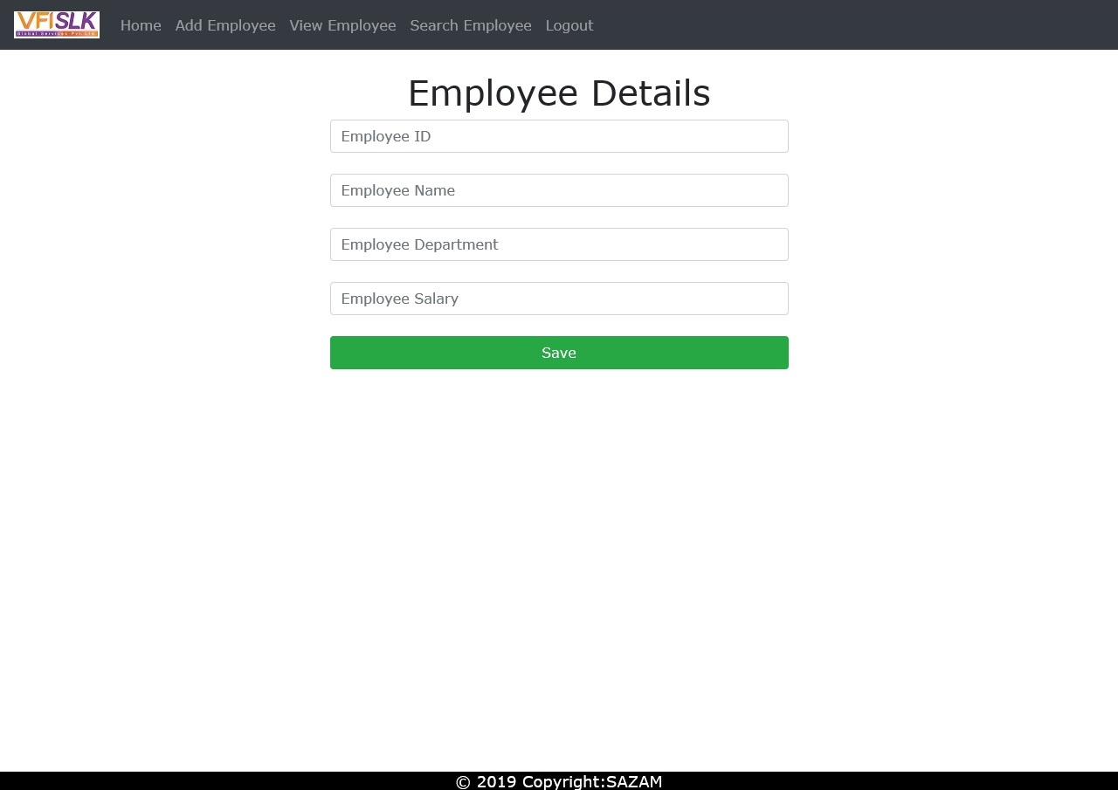
Add Employee

Slide 10
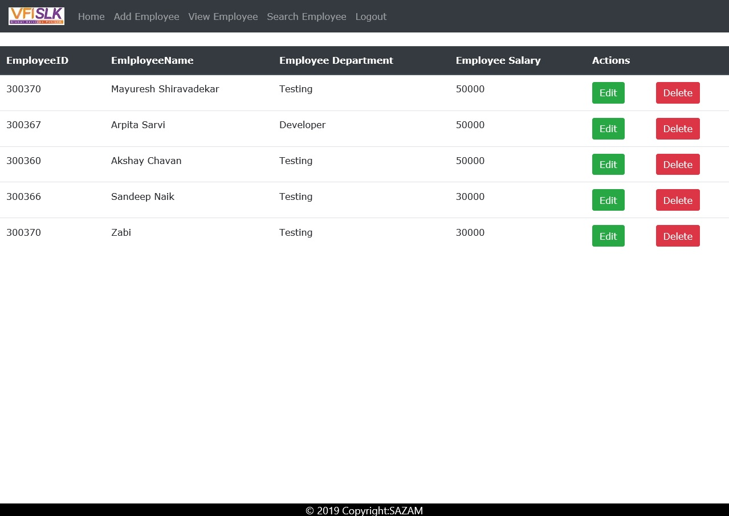
View Employee

Slide 11
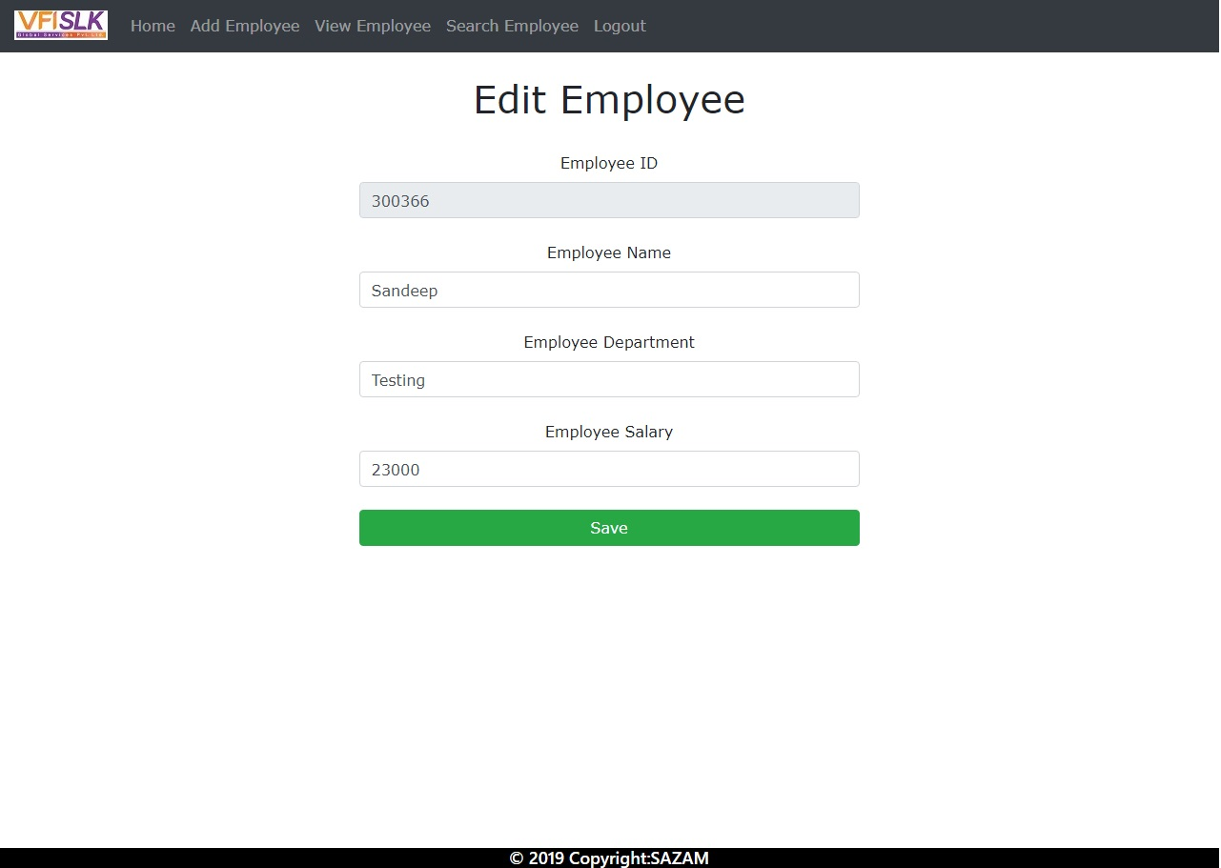
Edit Employee

Slide 12
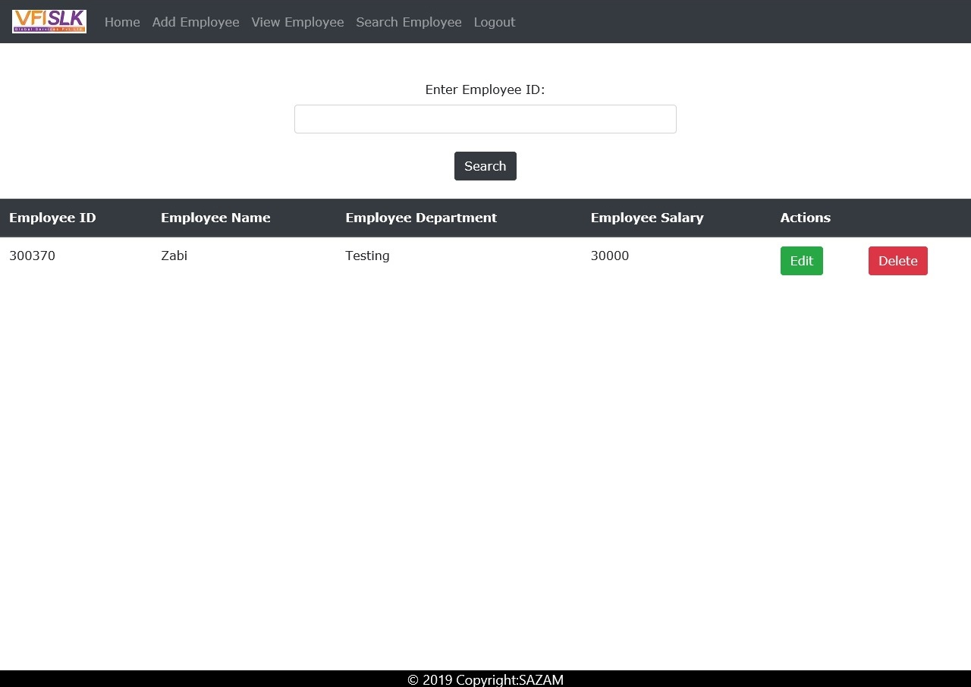
Search Employee

Slide 13
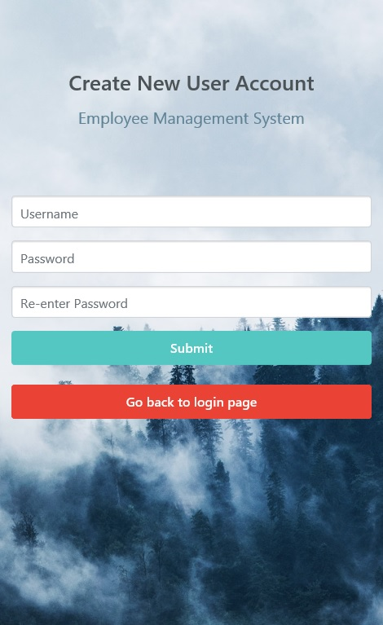
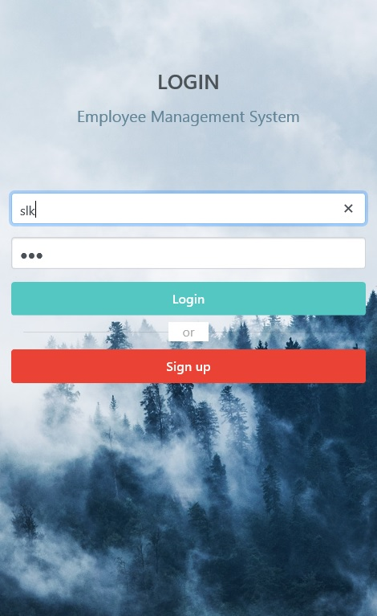
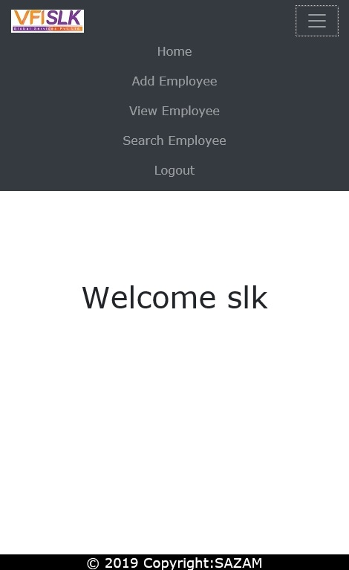
Mobile Friendly

Slide 14
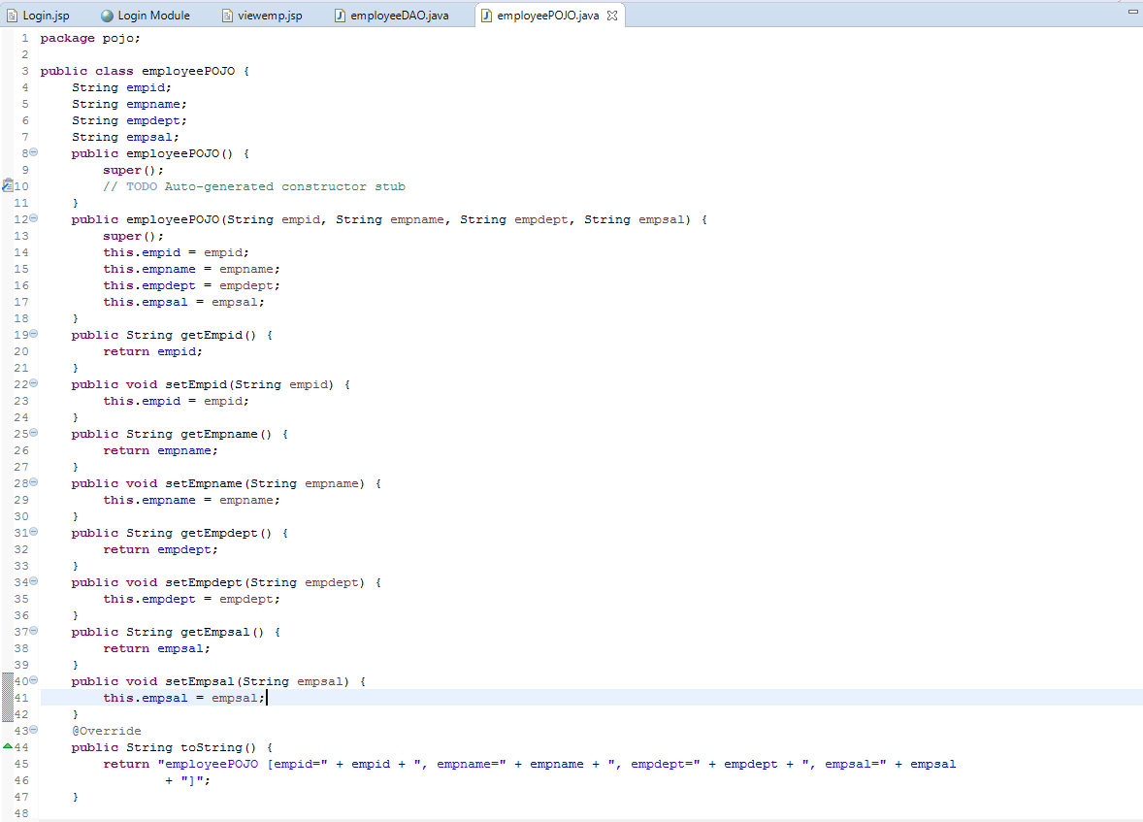
Sample Code- EmployeePOJO

Slide 15
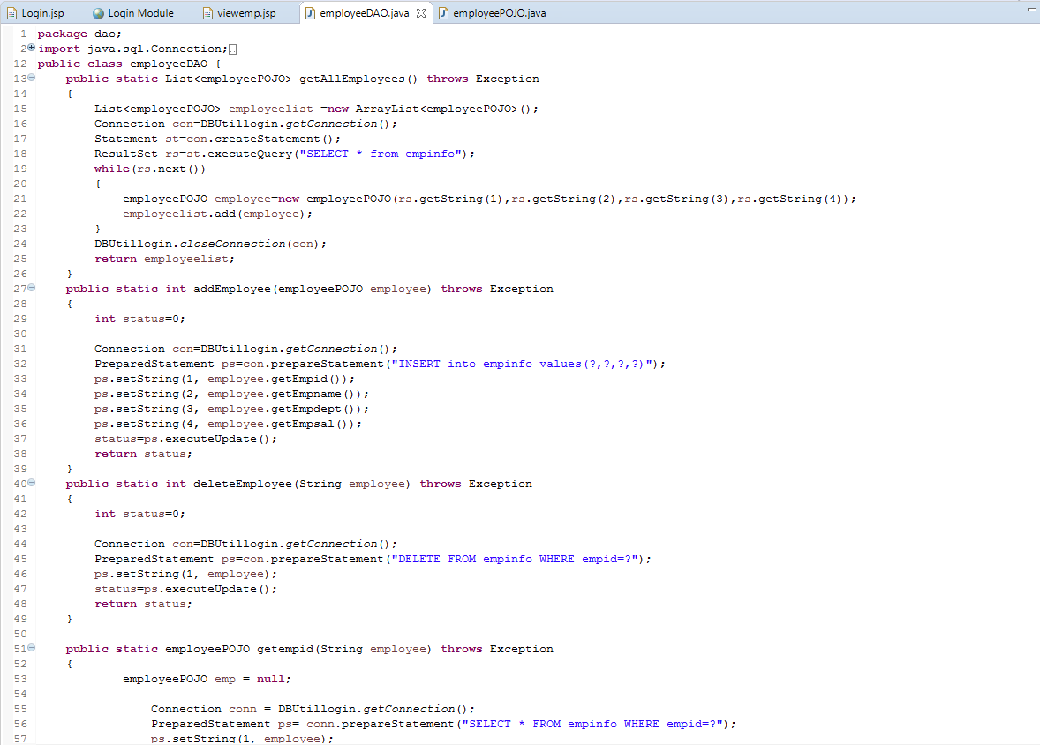
Sample Code- EmployeeDAO

Slide 16
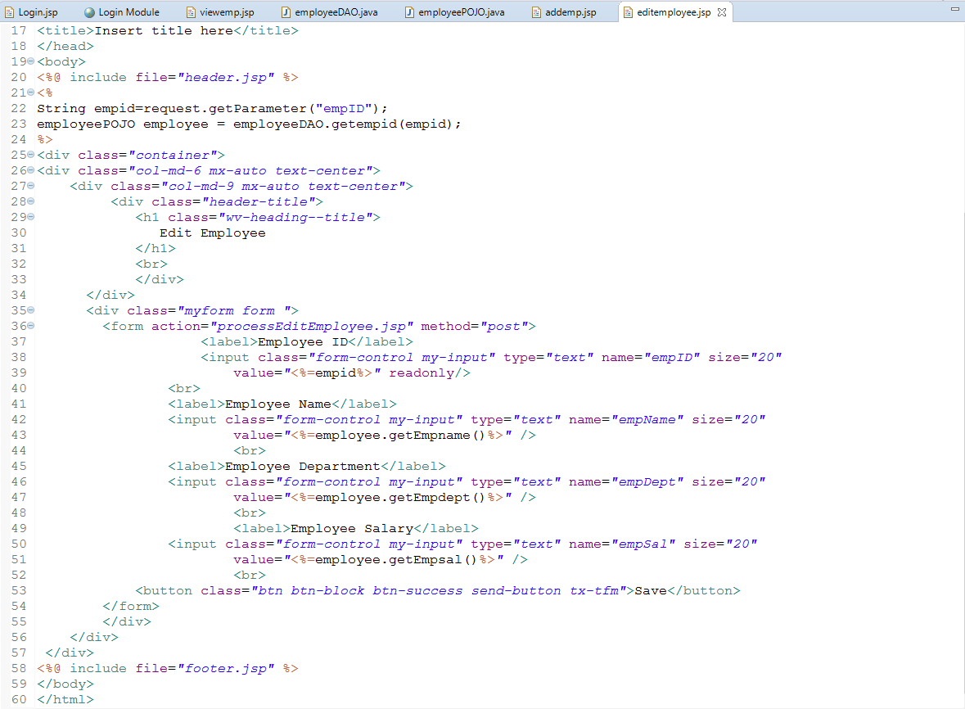
Sample Code- Edit Employee

Slide 17
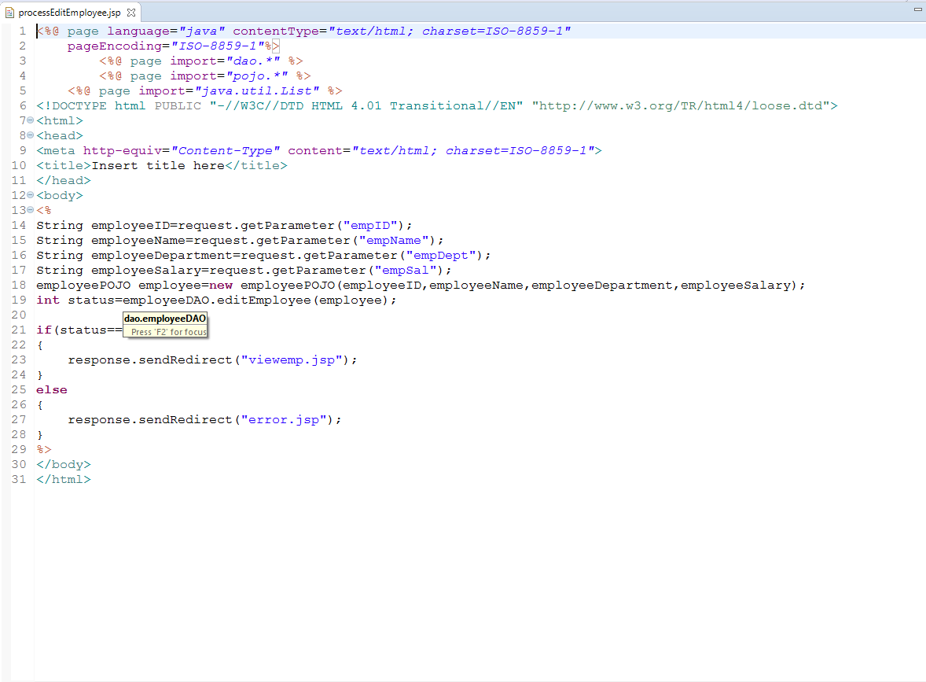
Sample Code- Edit Process

Slide 18
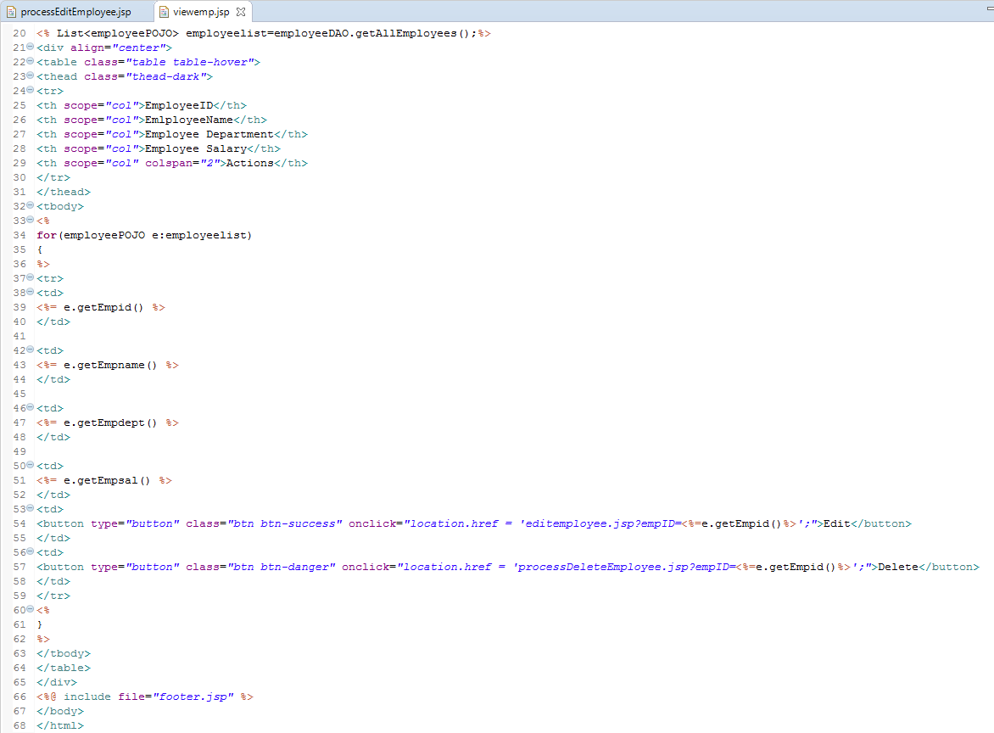
Sample Code- View Employee

Slide 19
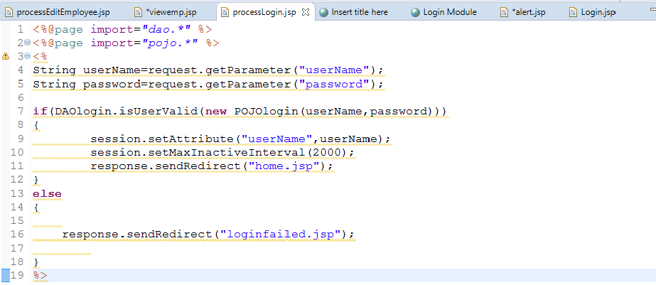
Sample Code- Session Management
Set Username as session attribute to maintain session

Slide 20
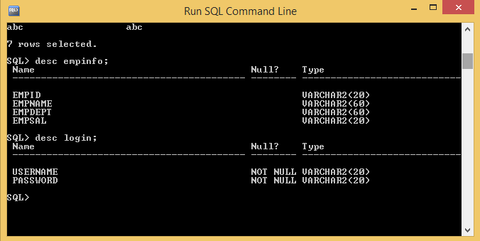
Sample Database

Slide 21
Test Automation

Slide 22
SoapUI
SoapUI tool is used to test SOAP(Simple Object Access Protocol) and REST(Representational State Transfers).
Project Environment
OS: Windows
Tool: SOAP UI
Programming Language: Groovy Script.

Slide 23
AUT - Features
Add Employee Details: This feature enables the user to enter the information of the employees.
Get Employee Details: This feature displays the details of the employee which are entered.
Delete Employee Details: This feature enables the user to delete the information of the employee.

Slide 24
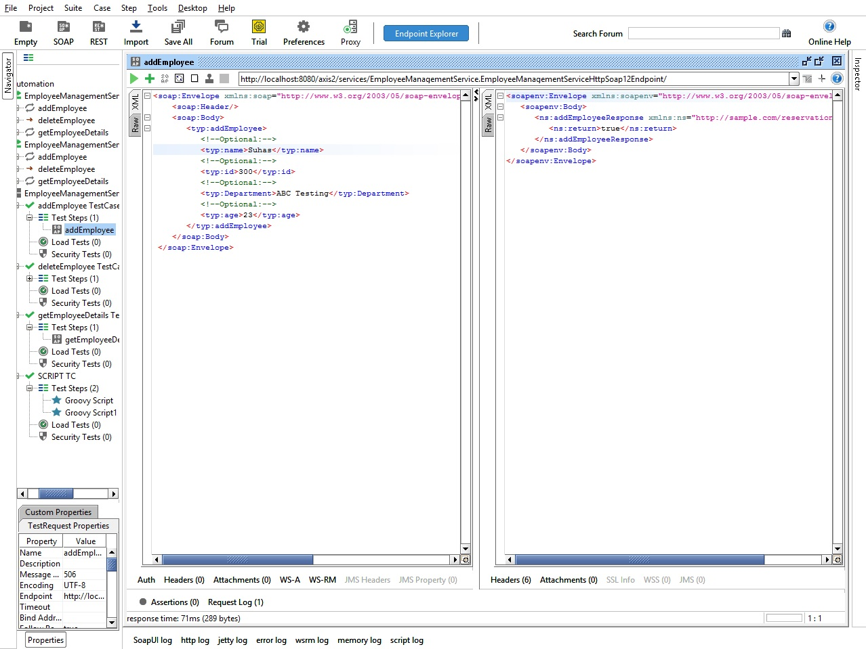
Manual Testing- Add Employee

Slide 25
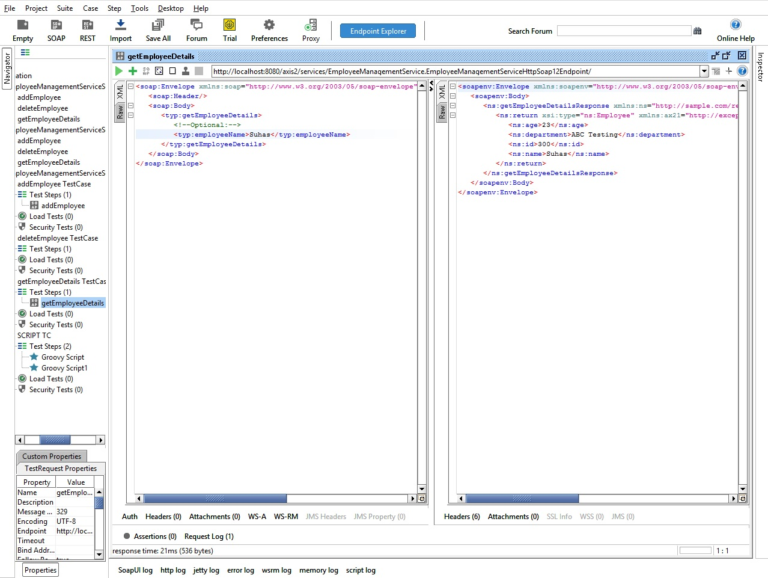
Manual Testing- Get Employee

Slide 26
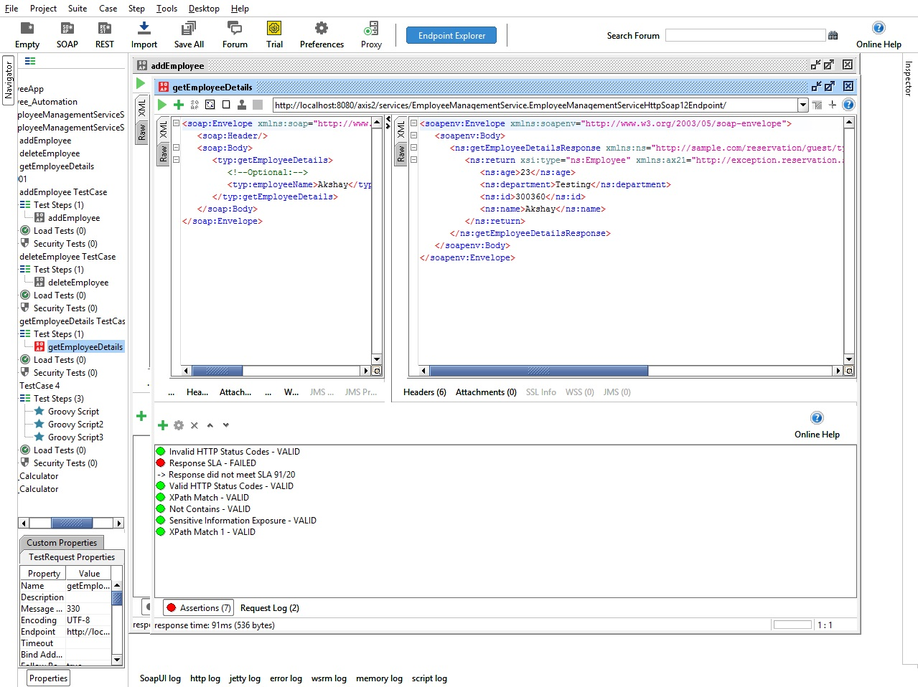
Manual Testing- Assertions
List of Assertions

Slide 27
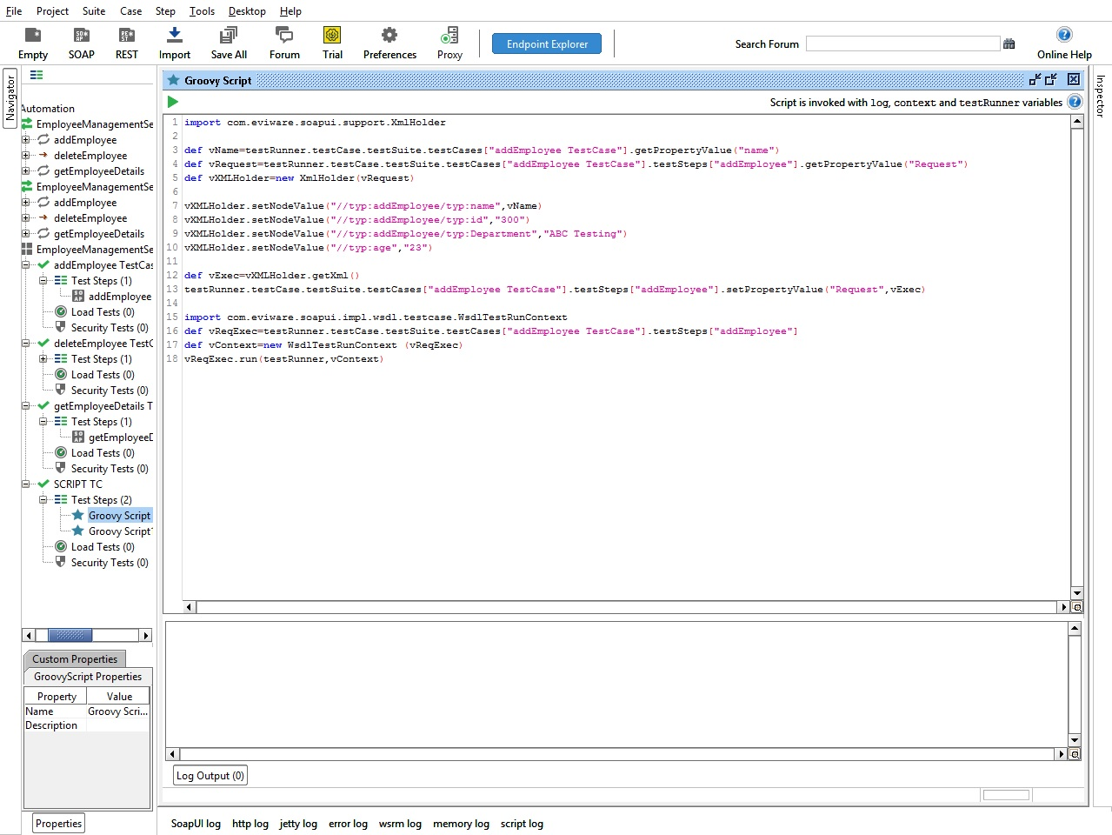
Automation Testing- Add Employee

Slide 28
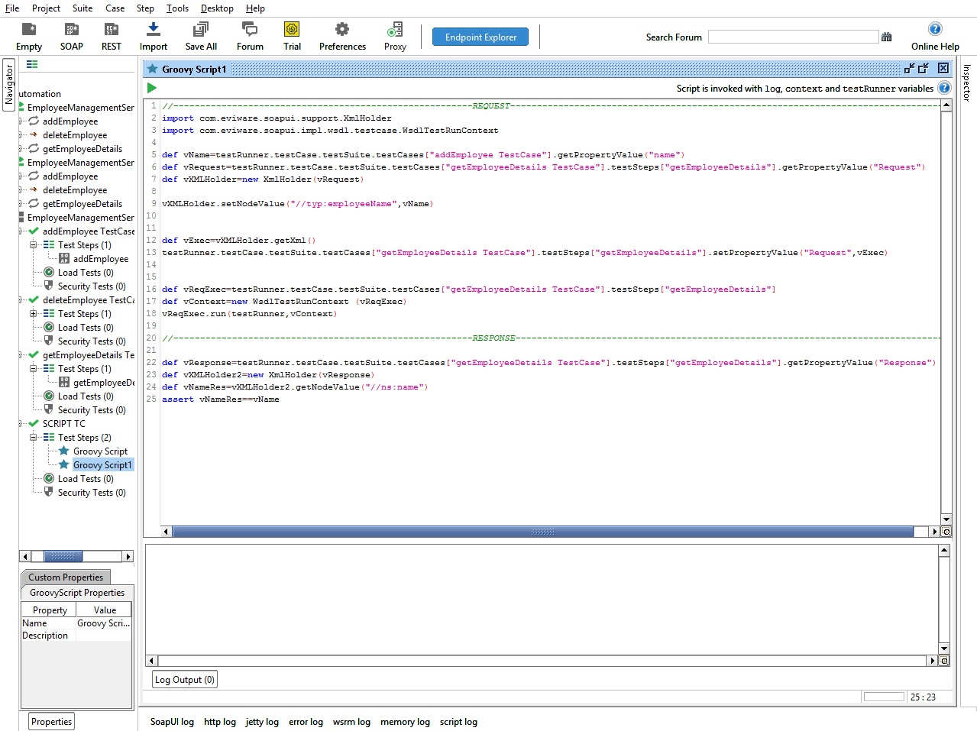
Automation Testing- Get Employee

Slide 29
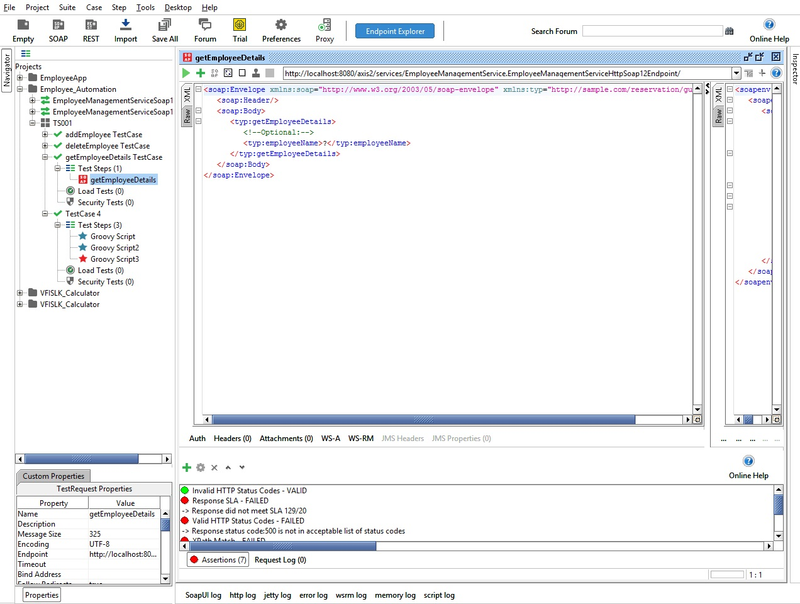
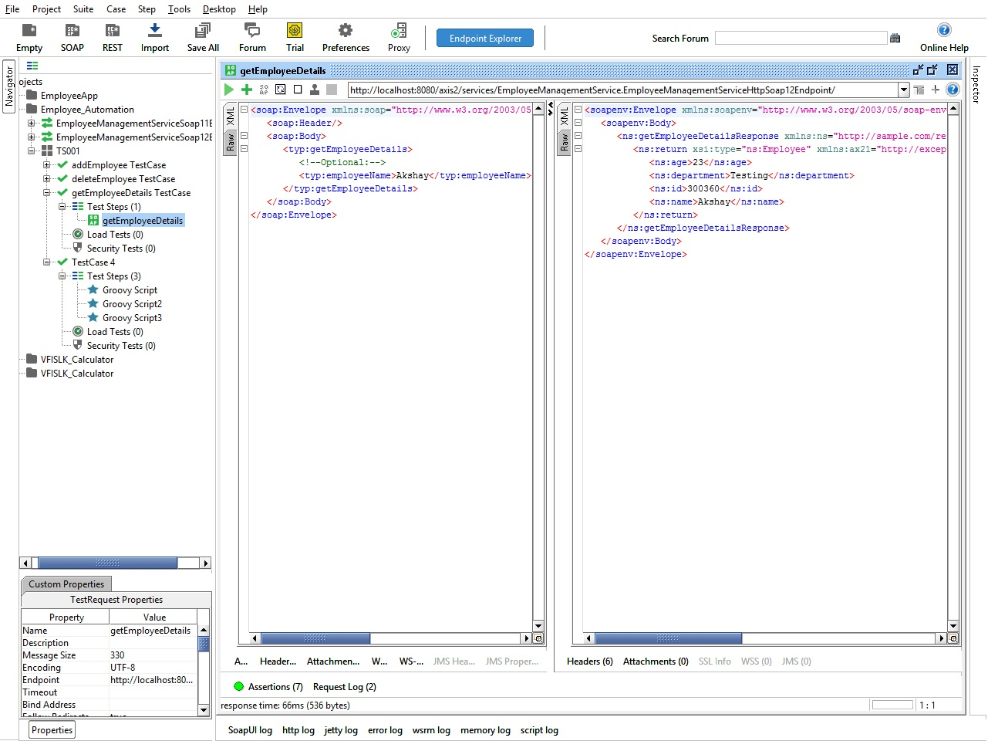
Automation Testing- Get Employee-Test Case Result
Before Execution
After Execution

Slide 30
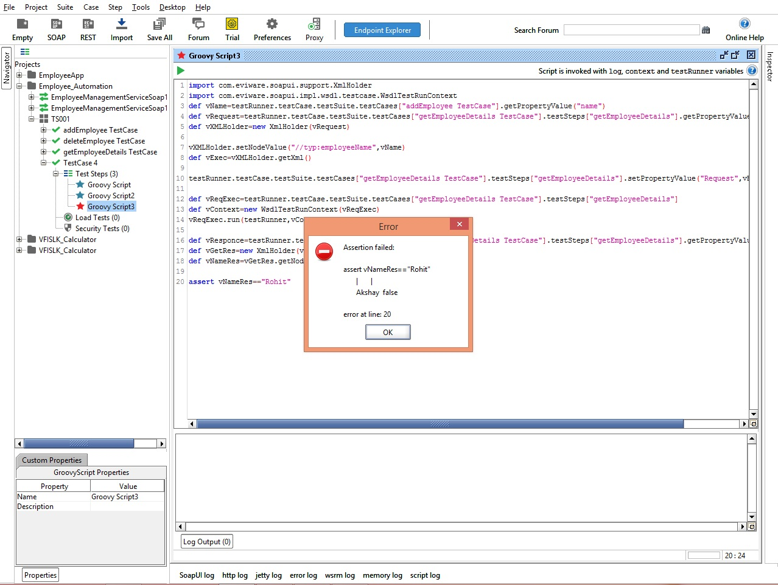
Automation Testing- Get Employee-Test Case Result
Test Case Fail

Slide 31
Employee Management System Automation Testing

Slide 32
Selenium
Selenium is a portable framework for testing web applications. Selenium provides a playback tool for authoring functional tests without the need to learn a test scripting language.
Project Environment
OS: Windows
Tool: Selenium
Programming Language: JAVA

Slide 33
AUT - Employee Management System
AUT - Features to be Tested:
Sign Up
Login
Add Employee
View Employee
Edit Employee
Search Employee

Slide 34
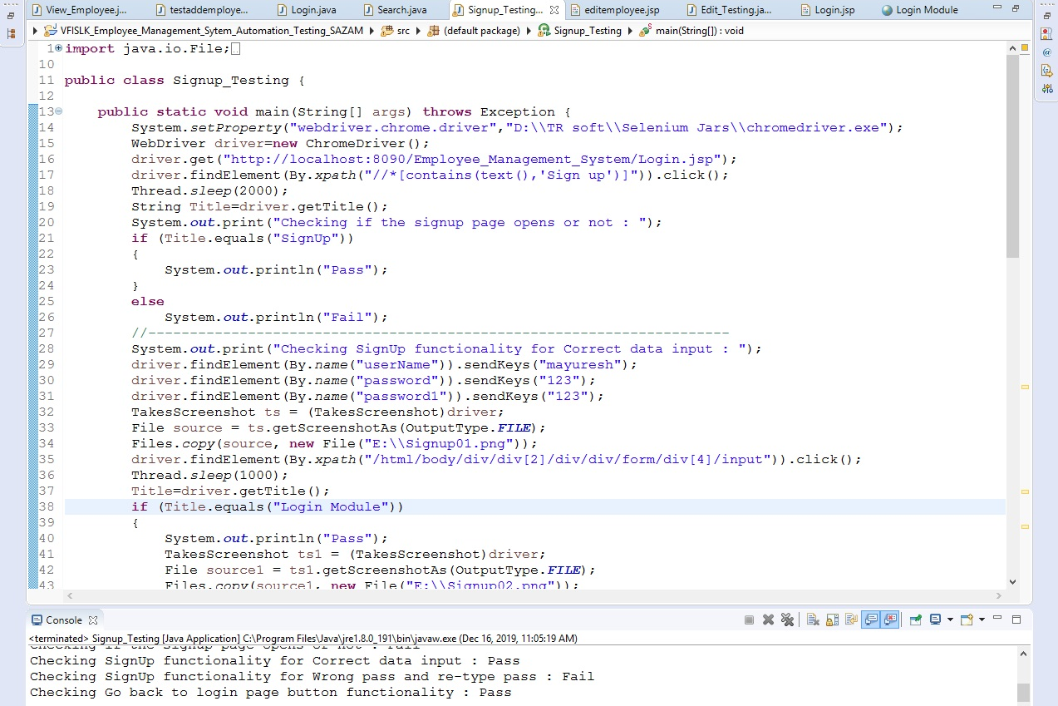
Sign Up– Sample Script
Sign Up page enables the user to register into the system.

Slide 35
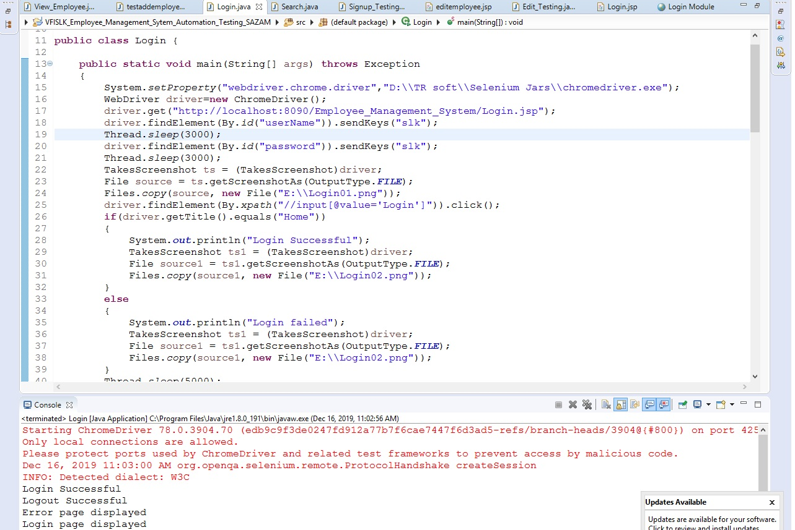
Login– Sample Script
Login page enables the user to Login into the system.

Slide 36
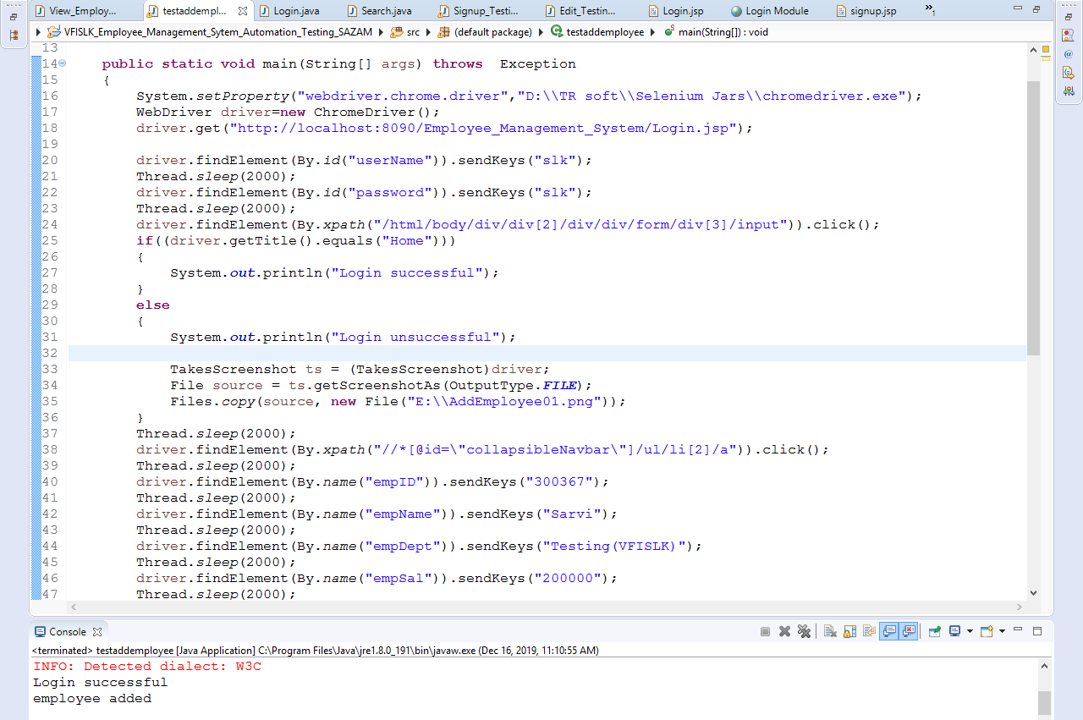
Add Employee– Sample Script
Add employee enables the user to add a new employee to the system.

Slide 37
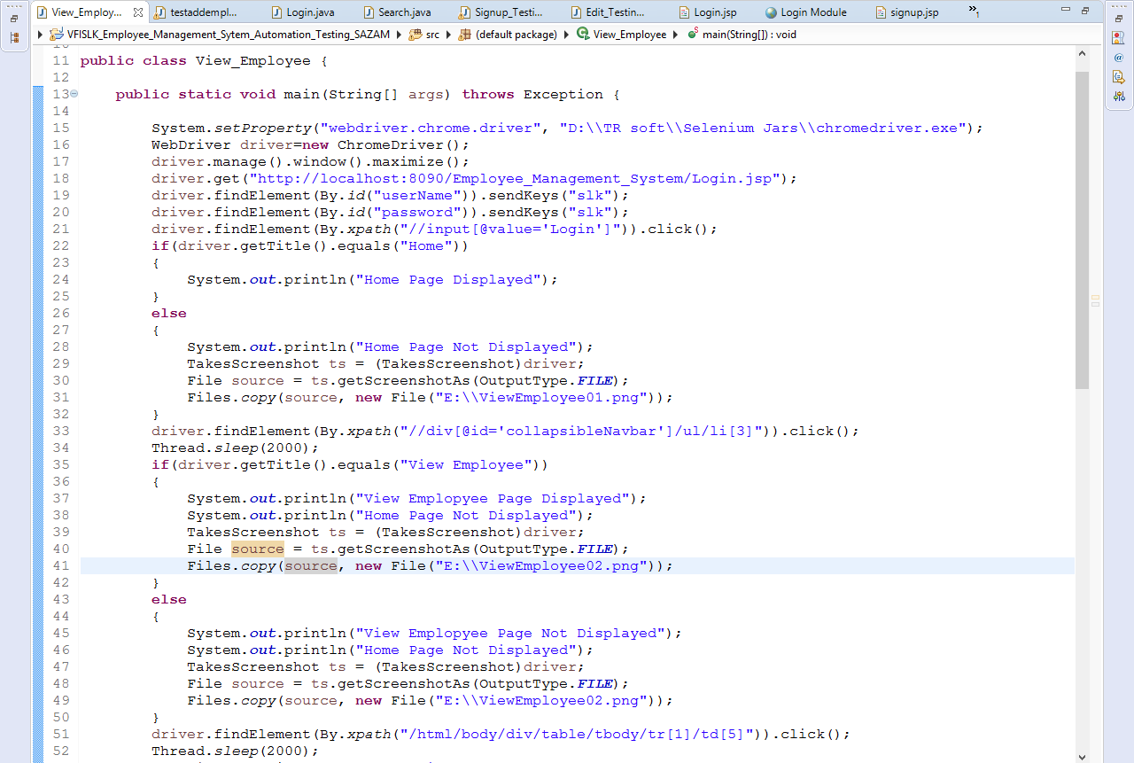
View Employee– Sample Script
View Employee page enables the user to view the list of registered employees in the system.

Slide 38
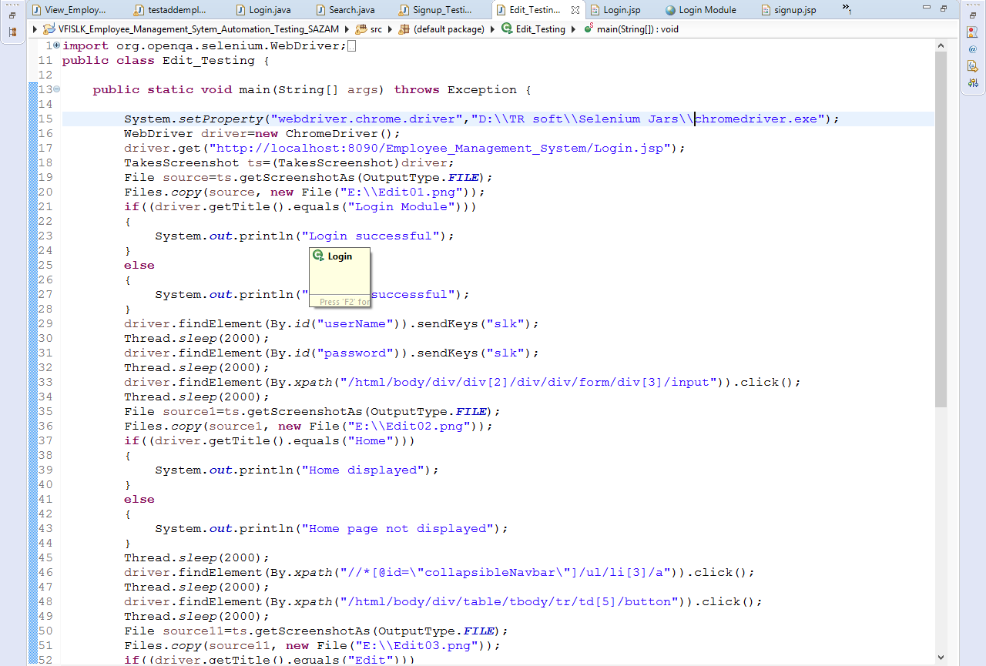
Edit Employee– Sample Script
Edit Employee page enables the user to edit employee details from the registered employees in the system.

Slide 39
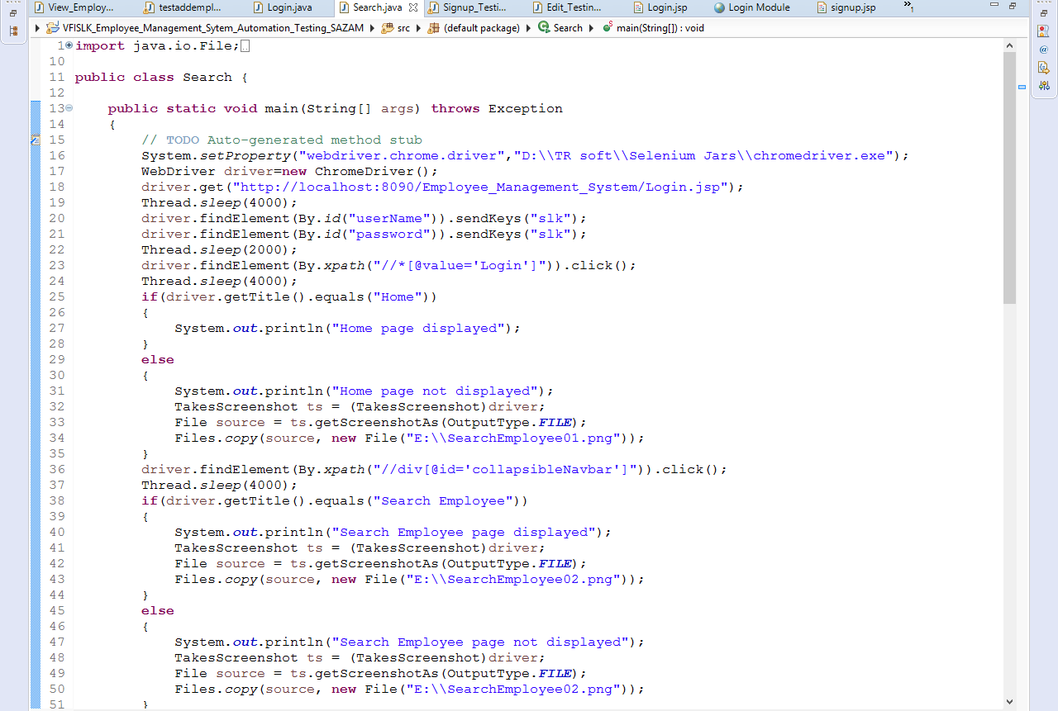
Search Employee– Sample Script
Search Employee page enables the user to search the registered employees in the system.

Slide 40
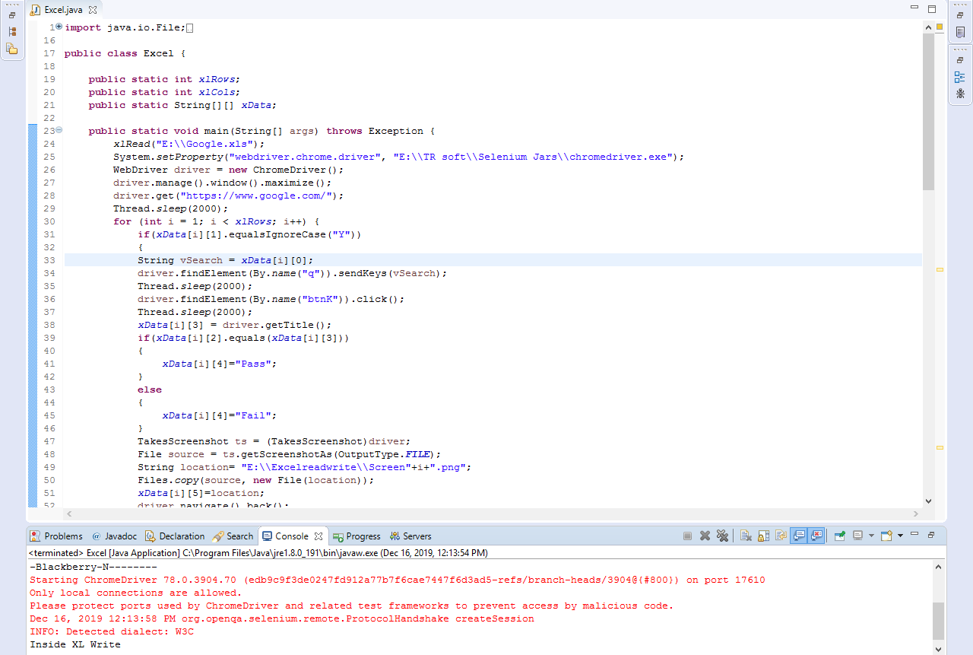
Google Search – Case Study 1
Retrieving the data from the Excel sheet, searching it in Google and updating the status & screen shot location in the Excel sheet.

Slide 41
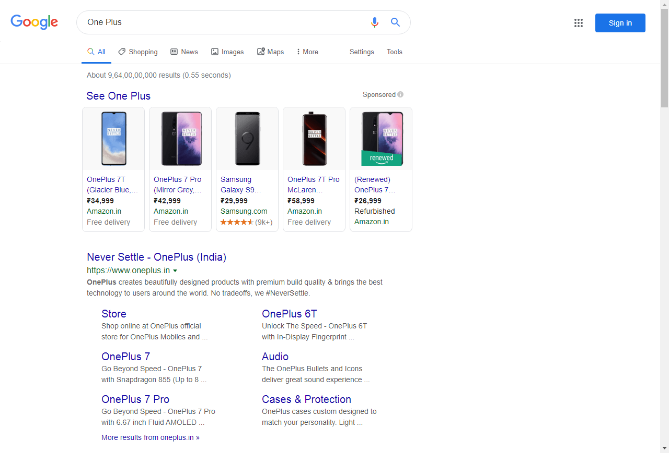
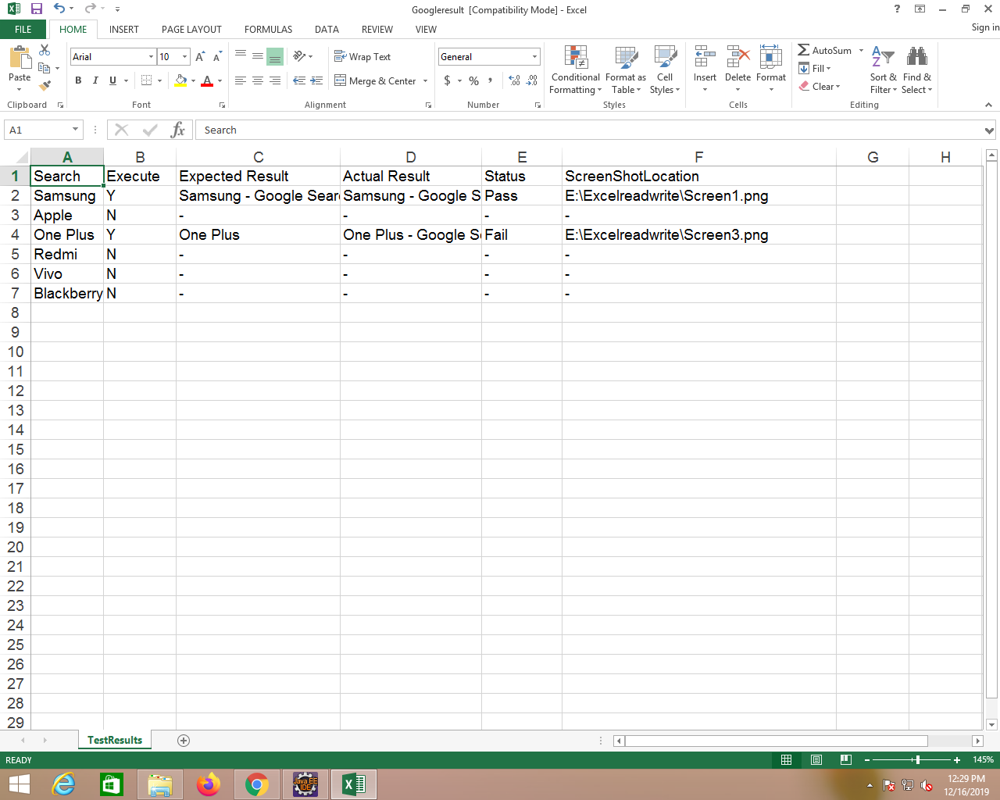
Search Result using Data Driven Framework(DDF)
Result-Google Search
Excel Sheet

Slide 42
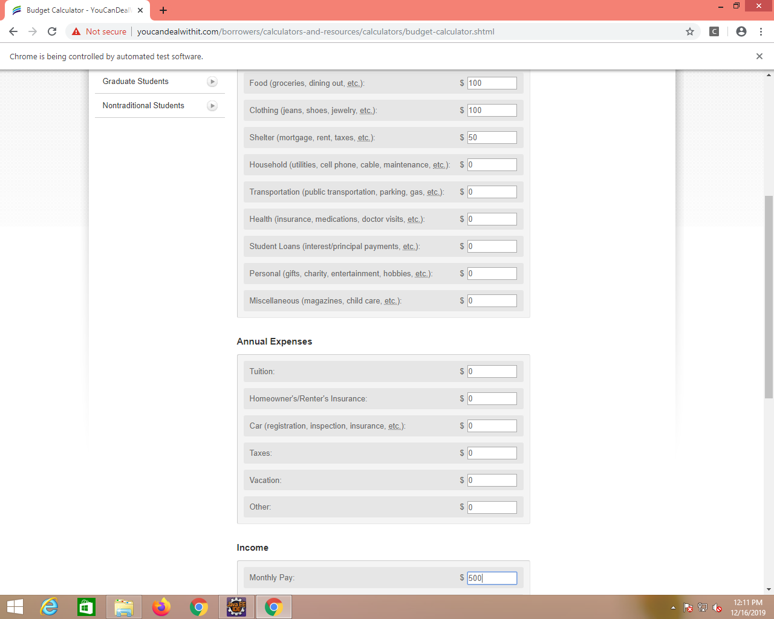
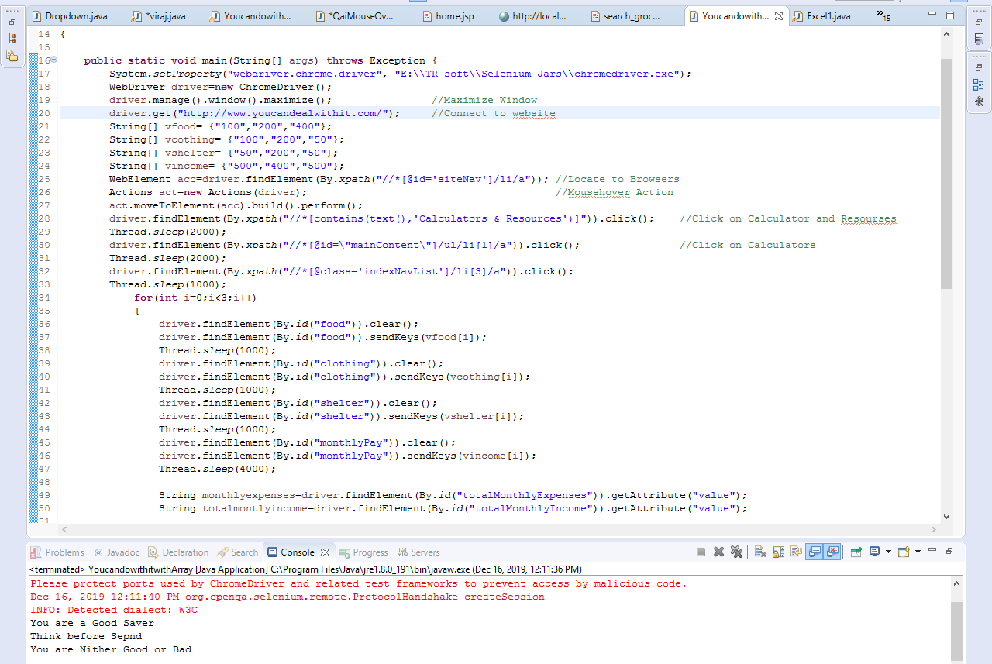
Budget Calculator– Case Study 2
Retrieving data from array, entering the data in budget calculator fields and displaying calculated results.
Code
Output

Slide 43
Source Code
Development Project Source Code
https://github.com/akshaychavan97/Employee-Management-System
Automation Project Source Code
https://github.com/akshaychavan97/TestAutomation
https://github.com/mayureshps/TestAutomation
https://github.com/ArpitaSarvi/TestAutomation
https://github.com/zabimd18/TestAutomation
https://github.com/Sandeep-174/TestAutomation

Slide 44
Thank You

